Slide 1





MINNESOTA
JUNE 2021 STATEWIDE
VOTER SURVEY
KEY FINDINGS FROM A SURVEY OF 500 VOTERS IN MINNESOTA
CONDUCTED JUNE 2-6, 2021

Slide 2

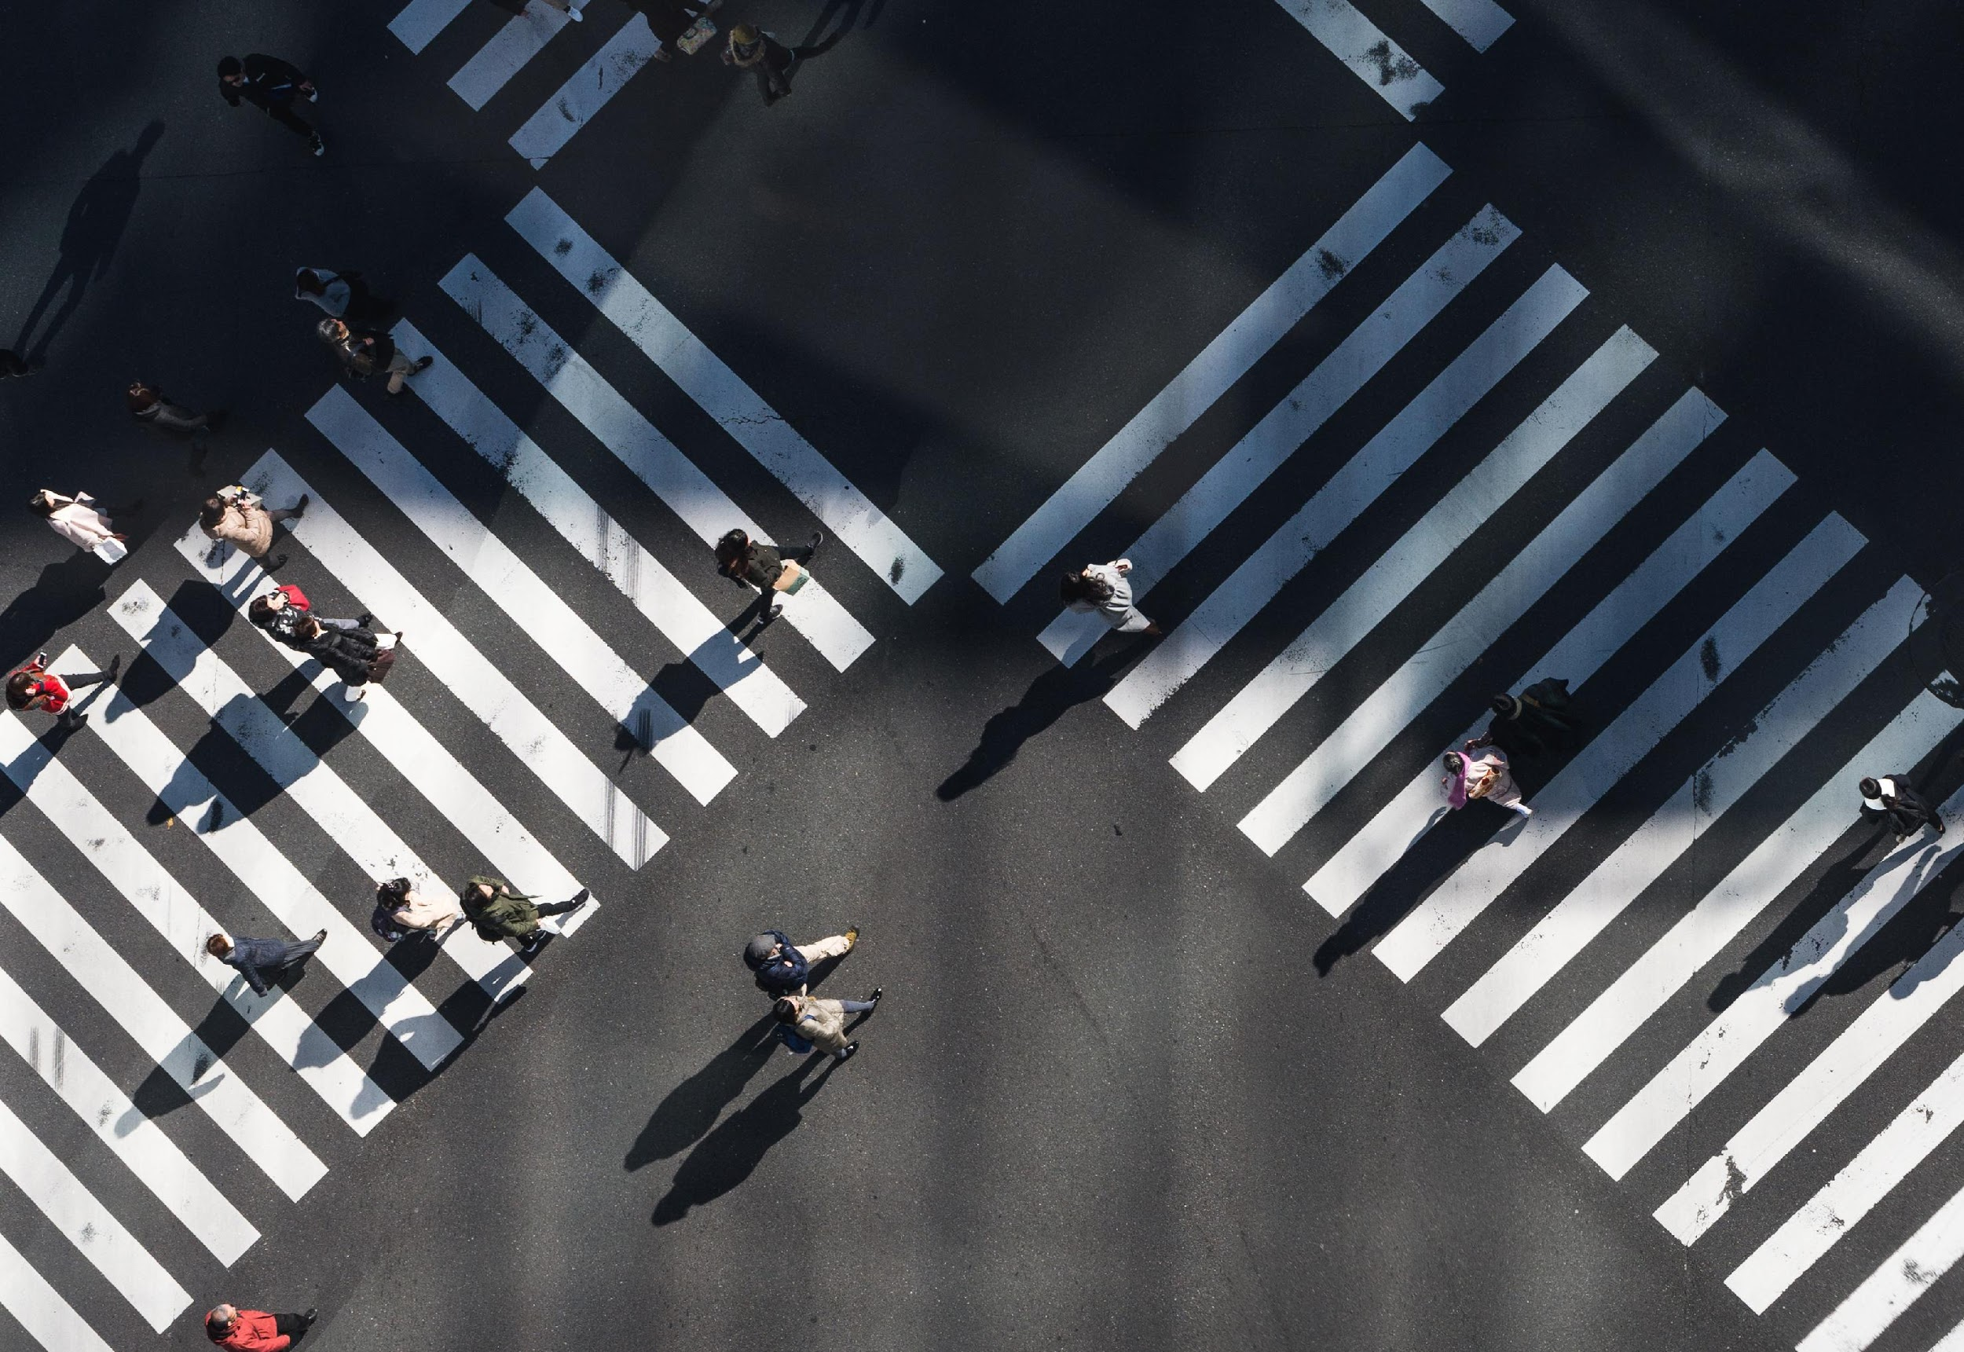

THINKING MINNESOTA: JUNE 2021 POLL
2
RESEARCH METHDOLOGY
Meeting Street Research is pleased to present the Minnesota Center of the American Experiment with the results of a survey conducted among registered voters in Minnesota.
Interviews were completed June 2-6, 2021, among 500 registered voters with a mix of cell phone and landline interviewing.
The margin of error for a sample size of N=500 is ±4.38%.

Slide 3
Opinions about Minnesota’s direction are noticeably more negative now compared to two years ago.
“Generally speaking, would you say that things in Minnesota are going in the right direction, or have they gotten off on the wrong track?”
+35 Right Direction | +19 Right Direction | +3 Wrong Track

Slide 4
Republicans are driving up the wrong track numbers, so are Minnesotans outside of the Twin Cities and its suburbs.
Minnesota Right Direction/Wrong Track By Key Subgroups
 | Right Direction | Wrong Track
Overall | 45% | 48%
Republicans | 14% | 81%
Independents | 38% | 52%
Democrats | 77% | 17%
Men 18-54 | 41% | 52%
Men 55+ | 46% | 49%
Women 18-54 | 47% | 46%
Women 55+ | 49% | 44%
Twin Cities | 54% | 37%
MSP Suburbs | 49% | 46%
Rest Of State | 36% | 58%
Shading Indicates Over-Index Overall By 5%+

Slide 5
Governor Walz’s approval handling the riots have flipped since last year; most Minnesotans now disapprove.
“And, thinking about the riots, looting, and arson that have occurred over the past year in Minneapolis, do you approve or disapprove of Governor Tim Walz's response?”
+24 Approve | +16 Disapprove

Slide 6
Approval has shifted decidedly more negative across every subgroup. Republicans, Independents, men under 55 and Minnesotans outside of the Twin Cities and suburbs are the governor’s biggest critics on this metric.
Governor Walz Job Handling Riots By Key Subgroups
June 2020
June 2021
 | Approve | Disapprove | Approve | Disapprove
Overall | 59% | 35% | 39% | 55%
Republicans | 30% | 62% | 10% | 88%
Independents | 56% | 37% | 31% | 60%
Democrats | 86% | 9% | 68% | 23%
Men 18-54 | 54% | 40% | 32% | 62%
Men 55+ | 56% | 38% | 40% | 55%
Women 18-54 | 64% | 28% | 35% | 58%
Women 55+ | 60% | 34% | 51% | 43%
Twin Cities | 68% | 26% | 49% | 42%
MSP Suburbs | 65% | 30% | 38% | 55%
Rest Of State | 50%* | 43%* | 33% | 64%
Shading Indicates Over-Index Overall By 5%+
*In June 2020, “Rest of State” includes Wright County.
In June 2021, “Rest of State” does NOT include Wright County.

Slide 7
Concern over crime in Minnesota is very high among adults overall and across the state, especially so in the suburbs.
“How concerned are you personally about the level of crime here in Minnesota?”
+63 Concerned | +58 | +70 | +60

Slide 8
Concern among women over 55 is very high.
Concern Over Violence In Minnesota By Gender/Age
+33 | +71 | +66 | +82

Slide 9
Shootings are the top concern for Minnesotans by a large margin.
Murder and hate crimes are also top concerns.
“Thinking generally about crime here in Minnesota, what two or three types of crime concern you most?”
Shootings
Murder
Hate Crimes
Burglary And Break-ins
Gang-related Violence
Robbery And Mugging
Car Theft And Carjacking
Aggravated Assault
Rape
Larceny And Theft
Don’t Know/Refused

Slide 10
Shootings and murder are top concerns shared by Minnesotans across parties. Hate crimes are a top concern for almost half of Democrats.
Most Concerning Types of Crime By Party
 | Overall | Republicans | Independents | Democrats
Shootings | 41% | 41% | 38% | 43%
Murder | 33% | 36% | 48% | 23%
Hate Crimes | 31% | 15% | 21% | 49%
Burglary And Break-ins | 24% | 28% | 20% | 22%
Gang-related Violence | 22% | 25% | 17% | 21%
Robbery And Mugging | 20% | 29% | 9% | 17%
Car Theft And Carjacking | 20% | 25% | 11% | 20%
Aggravated Assault | 18% | 16% | 27% | 15%
Rape | 16% | 14% | 16% | 19%
Larceny And Theft | 9% | 10% | 13% | 6%
Heat Map Indicates Top Three Choices Among Each Subgroup

Slide 11
Women report higher concern for shootings, murder, and hate
crimes than men do.
Most Concerning Types of Crime By Gender/Age
 | Overall | Men 18-54 | Men 55+ | Women 18-54 | Women 55+
Shootings | 41% | 35% | 34% | 43% | 50%
Murder | 33% | 28% | 29% | 39% | 35%
Hate Crimes | 31% | 29% | 22% | 40% | 30%
Burglary And Break-ins | 24% | 16% | 25% | 26% | 28%
Gang-related Violence | 22% | 19% | 27% | 17% | 27%
Robbery And Mugging | 20% | 23% | 19% | 19% | 18%
Car Theft And Carjacking | 20% | 16% | 18% | 19% | 25%
Aggravated Assault | 18% | 22% | 12% | 19% | 16%
Rape | 16% | 18% | 6% | 24% | 15%
Larceny And Theft | 9% | 11% | 10% | 7% | 7%
Heat Map Indicates Top Three Choices Among Each Subgroup

Slide 12
Four-in-five say crime in Minnesota has gotten worse over the past year.
“And, do you think crime in Minnesota has gotten worse over the past year?”
 | Yes | No
Republicans | 93% | 6%
Independents | 82% | 14%
Democrats | 68% | 28%
Men 18-54 | 78% | 19%
Men 55+ | 80% | 17%
Women 18-54 | 75% | 21%
Women 55+ | 86% | 11%
Twin Cities | 78% | 18%
MSP Suburbs | 82% | 17%
Rest Of State | 80% | 17%
17%
No
3%
Don’t
Know
Yes
80%
Shading Indicates Over-Index Overall By 5%+

Slide 13
Most Minnesotans, including Republicans and suburbanites, say they are visiting Minneapolis less frequently than they normally do.
“Over the past year, would you say you have visited Minneapolis more frequently, less frequently, or about the same amount as you usually do?”
 | More | Less | Same
Republicans | 3% | 73% | 19%
Independents | - | 56% | 36%
Democrats | 8% | 46% | 41%
Men 18-54 | 4% | 44% | 44%
Men 55+ | 1% | 67% | 26%
Women 18-54 | 7% | 69% | 22%
Women 55+ | 3% | 55% | 32%
Twin Cities | 5% | 55% | 32%
MSP Suburbs | 5% | 66% | 26%
Rest Of State | 3% | 54% | 35%
+54 Less Frequent
Shading Indicates Over-Index Overall By 5%+

Slide 14
Most Minnesotans say it will take some time before Minneapolis will feel safe.
“Looking ahead, when do you think Minneapolis will feel safe again?”
It Already Feels Safe
Later This Year
One To Two Years From Now
Three Or More Years From Now
Never
Don't Know/Refused
17%
Short-term
73%
Long-term

Slide 15
Length of time it will take for Minneapolis to feel safe again increases as distance from the Twin Cities increases.
When Minneapolis Will Feel Safe Again By Region
 | Overall | Twin Cities | MSP Suburbs | Rest Of State
Later This Year | 12% | 13% | 11% | 11%
One To Two Years From Now | 25% | 31% | 22% | 22%
Three Or More Years From Now | 29% | 26% | 43% | 24%
Never | 19% | 13% | 13% | 27%
It Already Feels Safe | 5% | 8% | 5% | 3%
Don't Know/Refused | 10% | 9% | 6% | 13%
Shading Indicates Over-Index Overall By 5%+

Slide 16
A lack of support for law enforcement is the top reason for crime in Minnesota among adults overall.
“Thinking about the various things that cause crime, which one of the following do you think is most responsible for the crime here in Minnesota?”
A Lack Of Support For Law Enforcement
Discrimination Against Minorities
Governor Walz' Lack Of Leadership
Weak Economy And Lack Of Job Opportunities
The Covid-19 Pandemic
Fatherless Homes
Leniency In Sentencing
Don't Know/Refused

Slide 17
A lack of support for law enforcement is the top reason Republicans and Independents say causes crimes; for Democrats it’s minority discrimination.
Responsibility For Most Crime By Party
 | Overall | Republicans | Independents | Democrats
A Lack Of Support For Law Enforcement | 26% | 44% | 29% | 10%
Discrimination Against Minorities | 16% | 2% | 8% | 32%
Governor Walz' Lack Of Leadership | 14% | 29% | 11% | 1%
Weak Economy And Lack Of Job Opportunities | 12% | 1% | 14% | 22%
The Covid-19 Pandemic | 10% | 3% | 11% | 16%
Fatherless Homes | 7% | 11% | 5% | 5%
Leniency In Sentencing | 6% | 7% | 6% | 7%
Don't Know/Refused | 9% | 4% | 15% | 8%
Heat Map Indicates Top Three Choices Among Each Subgroup

Slide 18
Minnesotans’ trust in law enforcement far exceeds their trust in their elected leaders to make Minnesota safe.
“Now, I'd like to read you a list of names and entities here in Minnesota. For each one, please tell me how much you trust that person or entity to make our state safer.”
+39 Trust | +1 Trust | +24 Distrust | +29 Distrust

Slide 19
Republicans, Independents, conservatives and moderates overwhelmingly trust law enforcement to make Minnesota safe.
Trust Law Enforcement By Party And Ideology
+73 Trust | +50 | +2 | +65 | +43 | -14

Slide 20
High overall trust in local police is unchanged from a year ago.
“Thinking about the police in your own local community, how much confidence, if any, do you have in the police in your local community to act in the best interests of the public?”
+71 Confident | +72 Confident

Slide 21
Republicans, men over 55, and Minnesotans outside of the Twin Cities report the highest confidence in their local police.
Confidence In Local Police By Key Subgroups
 | Confident | Not Confident
Overall | 86% | 14%
Republicans | 92% | 8%
Independents | 89% | 11%
Democrats | 79% | 21%
Men 18-54 | 86% | 14%
Men 55+ | 91% | 9%
Women 18-54 | 79% | 21%
Women 55+ | 89% | 11%
Twin Cities | 74% | 26%
MSP Suburbs | 90% | 10%
Rest Of State | 92% | 8%
Shading Indicates Over-Index Overall By 5%+

Slide 22
There is great concern for police recruitment, especially so among Republicans.
“Given the current environment, how concerned are you about Minnesota's ability to recruit qualified new police officers?”
+63 Concerned | +78 | +51 | +55

Slide 23
Women, especially over 55, are more concerned about police recruitment. Suburbanites are also more likely to be concerned.
Concern About Police Officer Recruitment By Key Subgroups
 | Concerned | Not Concerned
Overall | 81% | 18%
Men 18-54 | 73% | 25%
Men 55+ | 77% | 21%
Women 18-54 | 85% | 15%
Women 55+ | 87% | 12%
Twin Cities | 75% | 22%
MSP Suburbs | 86% | 13%
Rest Of State | 81% | 19%
Shading Indicates Over-Index Overall By 5%+

Slide 24
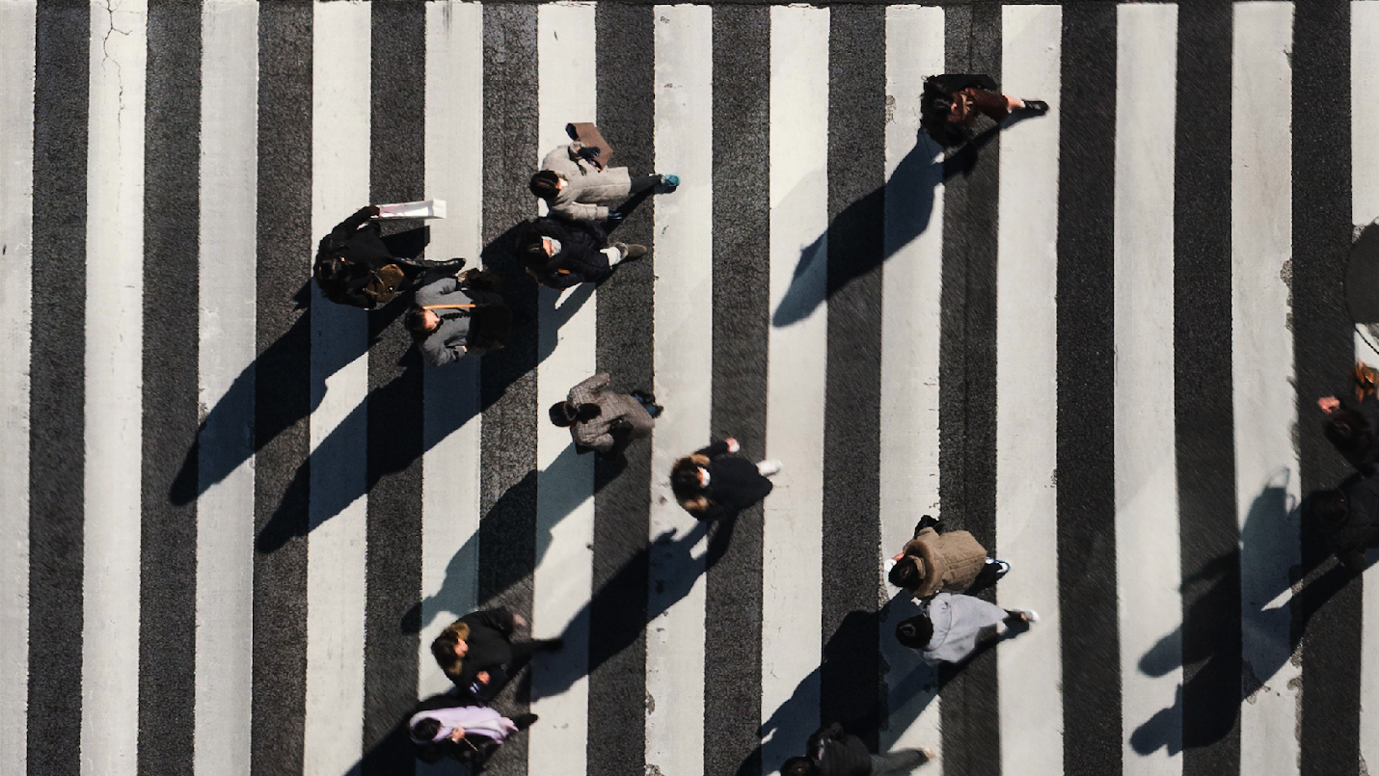
© 2020 Meeting Street Research, LLC. All Rights Reserved.

